Slide 2
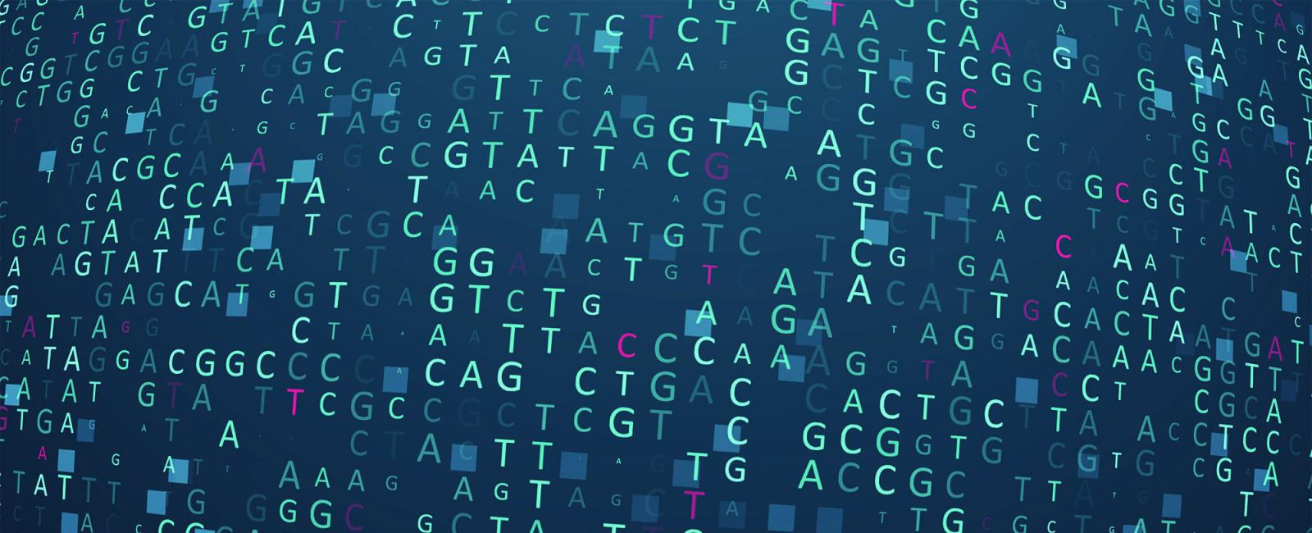


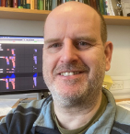



Prof. Matthew Berriman PI
School of Infection & Immunity,
College of Medical,Veterinary & Life Sciences,
University of Glasgow, UK
Part 2
parasite-help@wormbase.org
Dionysis Grigoriadis Bioinformatician
EMBL's European Bioinformatics Institute (EMBL-EBI), UK
Helminth Bioinformatics – Asia 2023
21-27 May 2023
KKU, Thailand

Slide 3
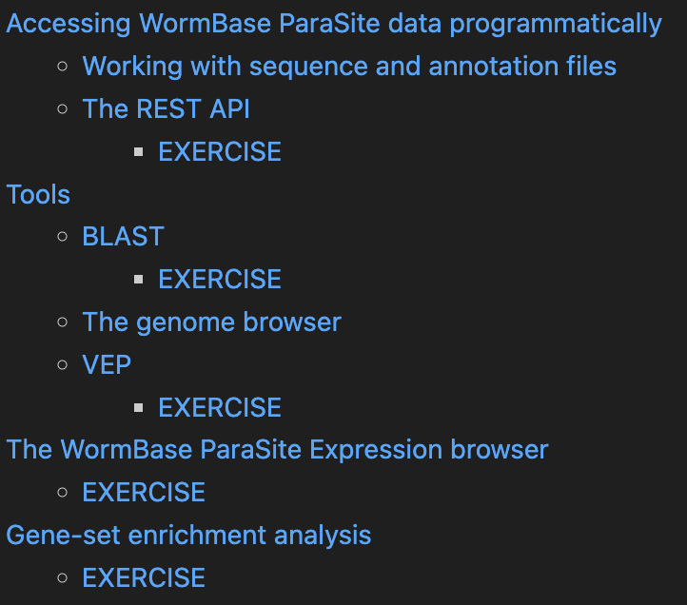
Part2
Notes:
This figure represents the steps that are needed to transform information encoded in the DNA into a polypeptide and eventually a functional protein. The starting information is encoded in the genome. A gene encodes, among other things, the transcription start and transcription end. These are the nucleotides from where an RNA copy of the DNA will be generated. UTRs. This is the gene’s transcript + multiple transcripts This copy is the pre-mRNA which is formed by exons and introns. Maturation of the mRNA molecule happens as it is transcribed and involves the splicing (removal) of introns with the concomitant joining of exons, addition of a CAP at the 5’ end and a polyadenylation tail (many As - AAAAAAA) at the 3’end. A processed mRNA will be the template for the translation of the mRNA message into a protein by the ribosome.

Slide 4


Accessing our data programatically
Downloads
REST API
List of various files stored in a structured FTP directory
set of rules and conventions for building and interacting with web services
FASTA
Annotation Files (GFF3)
Files listing orthologues/paralogues
And more…
Notes:
This figure represents the steps that are needed to transform information encoded in the DNA into a polypeptide and eventually a functional protein. The starting information is encoded in the genome. A gene encodes, among other things, the transcription start and transcription end. These are the nucleotides from where an RNA copy of the DNA will be generated. UTRs. This is the gene’s transcript + multiple transcripts This copy is the pre-mRNA which is formed by exons and introns. Maturation of the mRNA molecule happens as it is transcribed and involves the splicing (removal) of introns with the concomitant joining of exons, addition of a CAP at the 5’ end and a polyadenylation tail (many As - AAAAAAA) at the 3’end. A processed mRNA will be the template for the translation of the mRNA message into a protein by the ribosome.

Slide 5


BLAST
You can also do this with proteins!
Gene | Species | E-Score
Gene A | S. haematobium | 4.3e-63
Gene B | S. haematobium | 1e-20
Gene C | S. bovis | 0.05
….
TACGGCCCGGAAT
TACGGCCCGGAAT
TACGGCCCGGAAT
TACGGCCCGGAAT
GCGGTTAATTGCGGC
TACGGCCCGGAAT
GCGGTTAATTGCGGC
CGGAGCGCGTGGC
CGGAGCGCGTGGC
TACGGCCCGGAAT
CGGAGCGCGTGGC
TACGGCCCGGAAT
TACGGCCCGGAAT
TACGGCCCGGAAT
TACGGCCCGGAAT
TACGGCCCGGAAT
?
TACGGCCCGGAAT
TACGGCCCGGAAT
TACGGCCCGGAAT
TACGGCCCGGAAT
TACGGCCCGGAAT
TACGGCCCGGAAT
TACGGCCCGGAAT
TACGGCCCGGAAT
BLAST compares nucleotide or protein sequences to all sequences of WormBase ParaSite using local alignments
calculates the statistical significance of matches and ranks them in a table
parasite-help@wormbase.org
@WBParaSite
Notes:
BLAST stands for "Basic Local Alignment Search Tool (BLAST)". BLAST finds regions of local similarity between sequences. The program compares nucleotide or protein sequences to sequence databases and calculates the statistical significance of matches. BLAST can be used to infer functional and evolutionary relationships between sequences as well as help identify members of gene families.

Slide 6
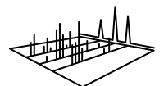
BLAST
When do we need to use it?
Identifying genes or proteins
Identifying orthologs and paralogs
RNDPKVSDYHPRSMHSENNVVTNPQPSSNKPSRPNPPTLPSQQKLNPTVSFNPPSSLSSSSTVVITTQAPTVNQISSNQQLSNQSMSNMLGMIKGGAGNLIRNIRDASTKVIGTVS
BLAST
Mass spectrometry on a schistosoma mansoni sample
Search for this sequence against all S. mansoni sequences to find what gene it belongs to.
Identified an unknown peptide
parasite-help@wormbase.org
@WBParaSite

Slide 7
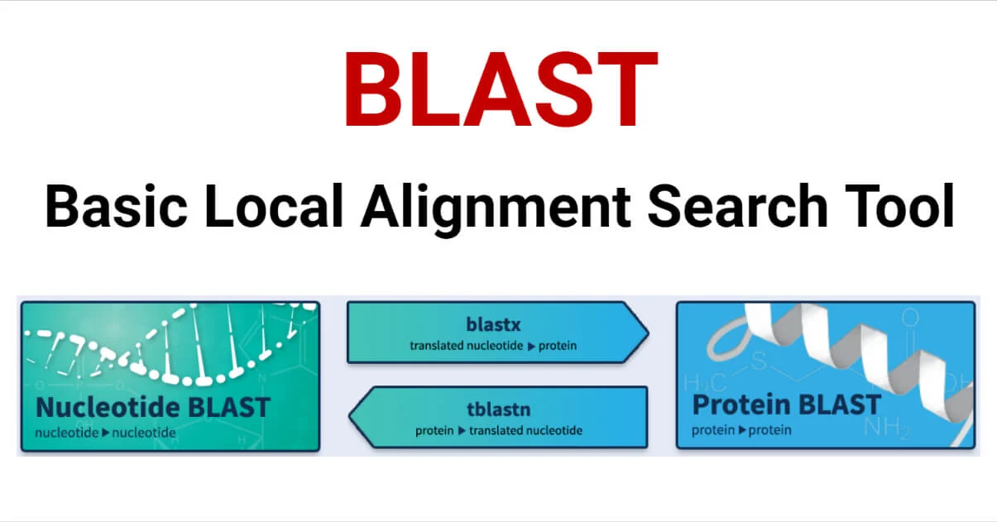
BLAST
When do we need to use it?
parasite-help@wormbase.org
@WBParaSite

Slide 8
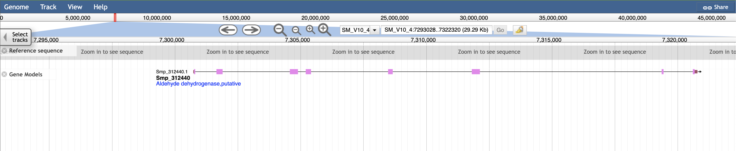
Genome Browsers
They are used to:
Visualise a gene model in its genomic context
Assess gene model correct
They are also used for visualising functional genomics data
parasite-help@wormbase.org
@WBParaSite

Slide 9
Variants Effect Predictor (VEP)
"We found 1 putative PZQ-R SNP in our reads supported by a very high read depth (Table S1, Fig. S7). This SNP (c.2708G>T on isoform 5, p.G903*) was found in a single Omani sample "
VEP is a tool that allows you to predict what the consequences of these variants are:
whether they fall within or near genes
whether they result in a change to the amino acid sequence of a protein
whether the resulted change is predicted to have a severe impact on the protein
parasite-help@wormbase.org
@WBParaSite
Notes:
BLAST stands for "Basic Local Alignment Search Tool (BLAST)". BLAST finds regions of local similarity between sequences. The program compares nucleotide or protein sequences to sequence databases and calculates the statistical significance of matches. BLAST can be used to infer functional and evolutionary relationships between sequences as well as help identify members of gene families.

Slide 10
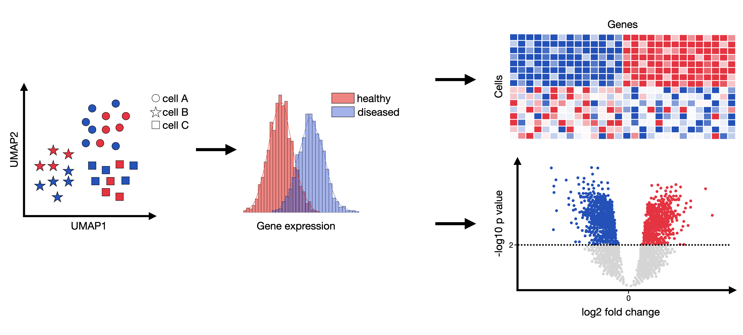
Gene Expression Portal
WormBase ParaSite has collated RNAseq data from publicly available studies and analysed it against our genomes and annotations
You can look up pre-calculated differentially expressed genes.
parasite-help@wormbase.org
@WBParaSite
Notes:
RNA-Seq is a technique to study gene expression by measuring RNA molecules in a sample. It helps identify which genes are active in a particular condition or tissue.
differential gene expression refers to the analysis of RNA-Seq data to identify genes that are differentially expressed between two or more conditions.

Slide 11
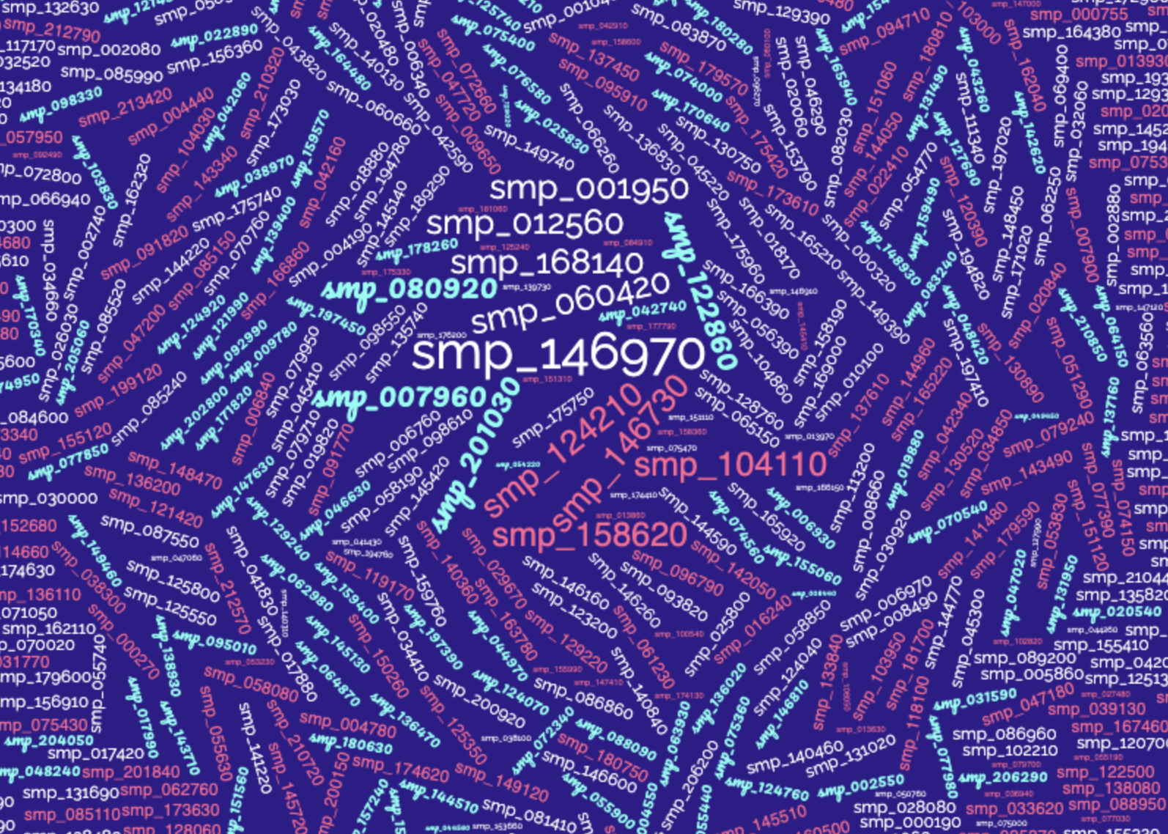
Gene-set enrichment analysis
All downregulated genes on 5-AzaC females!
parasite-help@wormbase.org
@WBParaSite
Notes:
BLAST stands for "Basic Local Alignment Search Tool (BLAST)". BLAST finds regions of local similarity between sequences. The program compares nucleotide or protein sequences to sequence databases and calculates the statistical significance of matches. BLAST can be used to infer functional and evolutionary relationships between sequences as well as help identify members of gene families.

Slide 12
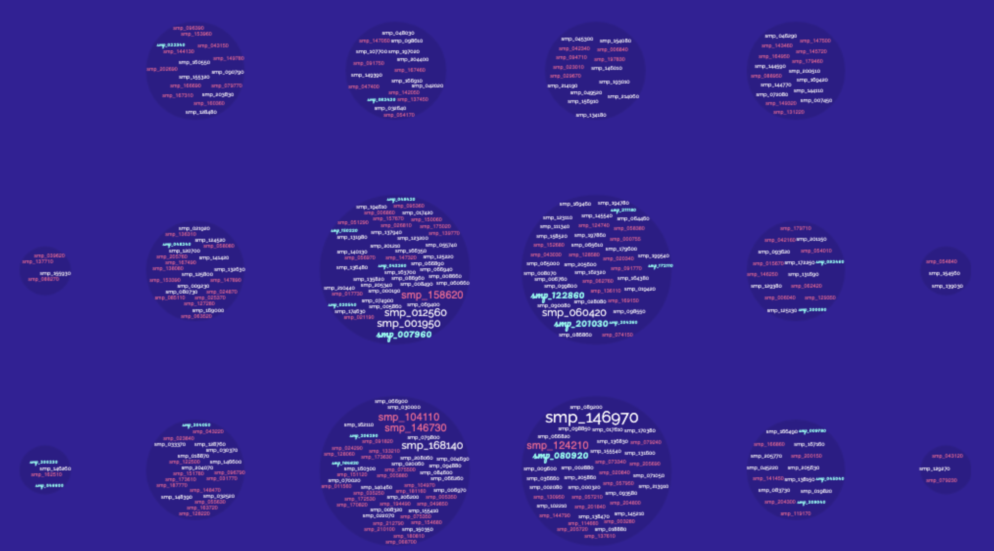

Gene-set enrichment analysis
purine ribonucleoside monophosphate metabolic process
ATP metabolic process
transmembrane transport
carbohydrate derivative metabolic process
oxidation-reduction process
carbohydrate derivative metabolic process
ion transport
transmembrane transport
generation of precursor metabolites and energy
pyruvate metabolic process
Gene enrichment analysis cluster genes with same Gene Ontology terms together into groups
parasite-help@wormbase.org
@WBParaSite
Notes:
BLAST stands for "Basic Local Alignment Search Tool (BLAST)". BLAST finds regions of local similarity between sequences. The program compares nucleotide or protein sequences to sequence databases and calculates the statistical significance of matches. BLAST can be used to infer functional and evolutionary relationships between sequences as well as help identify members of gene families.

Slide 13


We need your support!
Do you want WormBase ParaSite to continue to exist?
Please cite us
Talk about us
We need your feedback
@WBParaSite
parasite-help@wormbase.org
parasite-help@wormbase.org
@WBParaSite
Notes:
BLAST stands for "Basic Local Alignment Search Tool (BLAST)". BLAST finds regions of local similarity between sequences. The program compares nucleotide or protein sequences to sequence databases and calculates the statistical significance of matches. BLAST can be used to infer functional and evolutionary relationships between sequences as well as help identify members of gene families.

Slide 14





Prof. Matthew Berriman PI
School of Infection & Immunity,
College of Medical,Veterinary & Life Sciences,
University of Glasgow
Dr. Sarah Dyer PI
EMBL's European Bioinformatics Institute (EMBL-EBI)
Dionysios Grigoriadis Bioinformatician
EMBL's European Bioinformatics Institute (EMBL-EBI)
Tuan Le Web Developer
EMBL's European Bioinformatics Institute (EMBL-EBI)
parasite-help@wormbase.org

